Slide 1
Breaking the chain through Blockchain
Decentralization, autonomy, and labour process in the Architecture Decentralised Autonomous Organisation (archiDAO)
Dr Theodore Dounas, Principal Lecturer, Scott Sutherland School of Architecture and Built Environment, Robert Gordon University, Aberdeen, Scotland
Dr Dimosthenis Kifokeris, Assistant Professor, Department of Architecture and Civil Engineering, Chalmers University of Technology, Gothenburg, Sweden
Notes:
Add image of a token

Slide 2
Outline
Architecture-Engineering-Construction (AEC) firms are run in a neo-Taylorist manner: Top-down structures, work intensification, output optimisation
We present “archiDAO”, a blockchain-enabled, labour-production model in AEC that works bottom-up – via worker & unit of production autonomy using stigmergic principles inspired by the Viable System Model
We will show the concepts and structure of the organisation, along with its smart contracts & computing protocols

Slide 3
Problem statement
AEC firms are run in a neo-Taylorist manner: top-down structures, work intensification, output optimisation
No worker autonomy
No governance
Unfair stakes on output
Fragmentation of labour

Slide 4
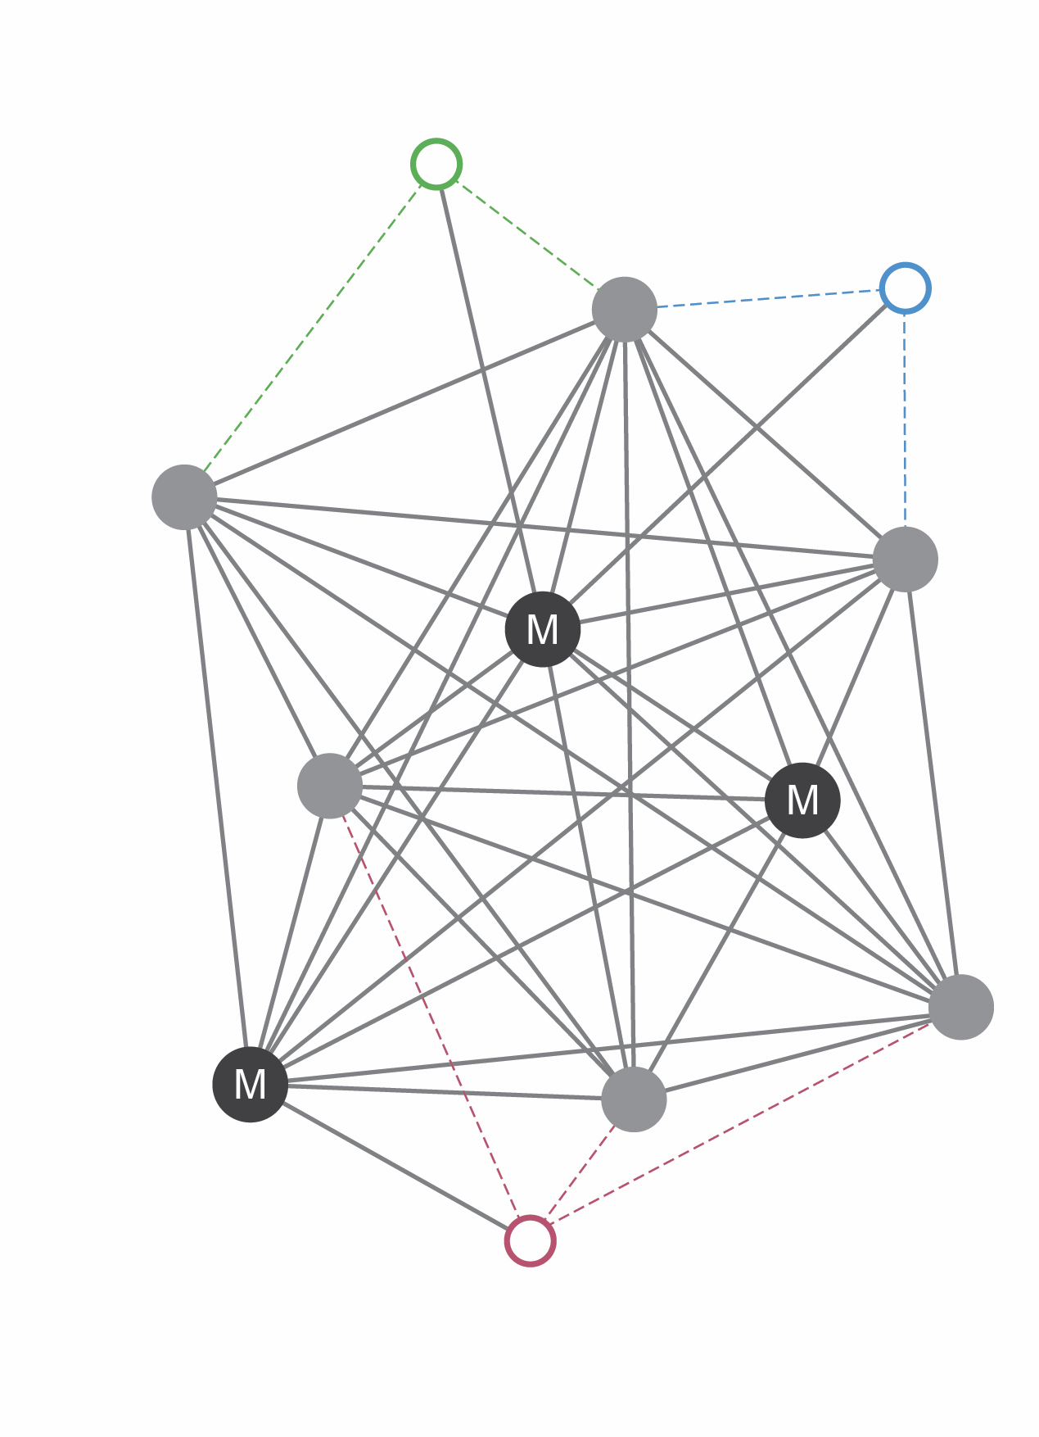
Blockchain
101
1
Blockchain: General-purpose digital technology claimed to foster decentralized digital ecosystems via automated peer-to-peer transactions with a reduced need for third-party intermediaries – aimed at generating trust and transparency
General-purpose technology: Potentially benefiting many industries, initiating innovations in other fields, and shaping long-term macroeconomic dynamics (Filippova 2019)

Slide 5


Blockchain
101
1
Blockchain mentioned as solution to trust in transactions, cybersecurity, corruption, digital information and goods provenance (traceability)
Smart contracts enable trustless, “decentralised” automatic execution of code with no intermediaries and need of permission
One can build intricate functionality on a smart contract, including non-fungible and fungible tokens

Slide 6
Blockchain is a
governance technology
Change this with a blockchain governance
1

Slide 7
Theory
Labour Process Theory, Autonomy, Control

Slide 8
How to build autonomy through technology?
Braverman (1974): Management deploys technology to control workers & work process → but this universalist thesis has since been contested in LBT research
Alvesson & Willmott (1992,1996): Micro-emancipation
Thompson & Harley (2007): Management’s control on work processes results in deskilling – utilization of technology by workers can counter that
Edwards (1990), Thompson (2009,2010): Relative autonomy of workplace regulation dynamics
Koch (2000a,b): Unions, shop stewards, employees, can demand and acquire elements of an emancipatory management of technology on the basis of their collective power
Thompson & Smith (2009): Discretion of work tasks (also related to IT) is core to workers’ skill utilization
Briken et al. (2018): Highly skilled workers possess knowledge not controlled by management; while challenging employment relationships, workers can potentially facilitate their autonomy precisely through implementing digital technologies
Burawoy (2020): “Making out” and societal framing of capitalism
Steinhoff (2021): IT can provide the working class with new (albeit limited) capacities to achieve production beyond the circuits of capital
Notes:
Focus on Thomson & Harley 2007 and Edwards 1990, Thomson, 2009-2010

Slide 9
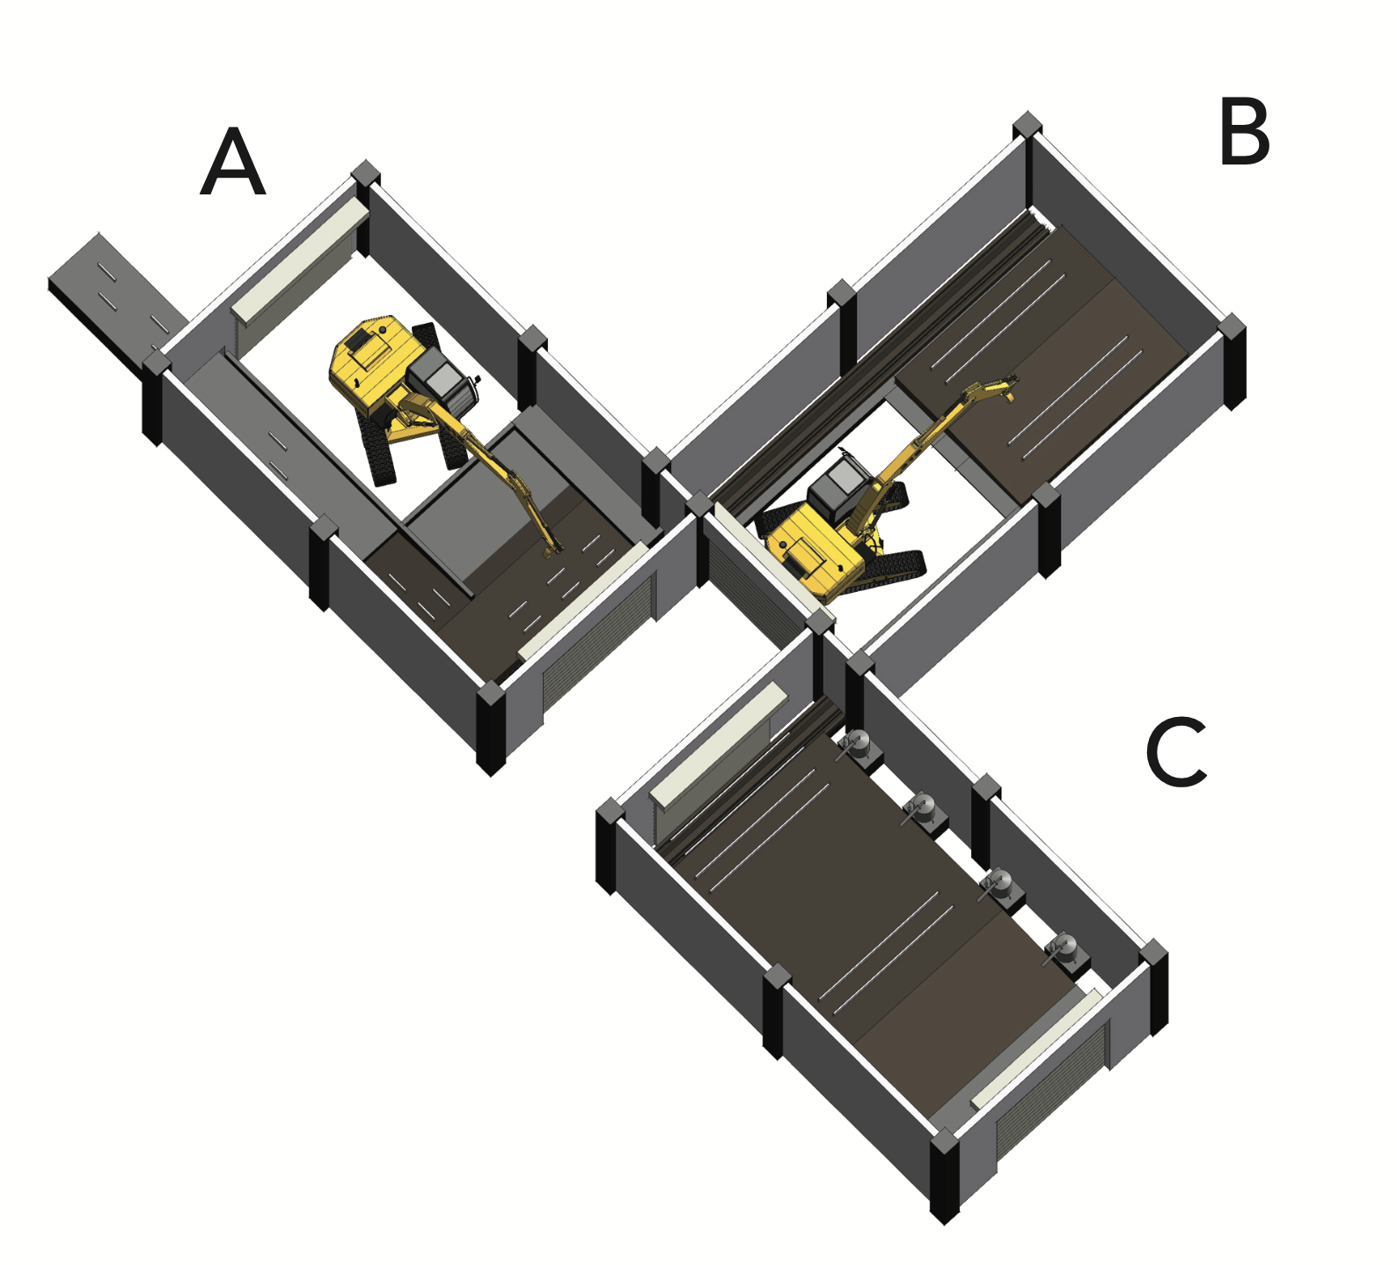
Architecture, Engineering, and Construction
101
AEC differs from manufacturing, “smart work” (i.e., start-ups, Internet companies), and the AI industry
A modified LBT understanding of using digital technologies for emancipation in AEC is needed

Slide 10
How to shift to using smart contracts as a basis of (worker) autonomy?
Clarke (1992): Capitalist building production signifies a transition from an artisan to a more (albeit not fully) industrial production through using technology
Haakestad & Friberg (2020), Erlich (2021), Ahlstrand (2022):
Wage labor, but also other precarious modes employment in AECO → worker misclassification, subcontracting, exploitation of temporary agency workers, deskilling
Power dynamics in work practices within construction → connected to employment relationships, production modes, and technology
Notes:
Illustrate through Briken et al -2018 / Steinhoff 2021

Slide 11
Architecture Decentralised Autonomous Organisation (archiDAO)

Slide 12

LPT
Notes:
To be discussed :
To explore possibilities of worker autonomy and (micro)emancipation (but also instances of control) through developing and implementing blockchain in AECO, we draw on panoptic empowerment and reflective conformity (Elmes et al. 2005), ”smart machines” (Zuboff 1987,2015), and the autonomy-control paradox (Bader and Kaiser 2017)
Autonomy-control scenarios:
Co-existence independently from each other
Hybridisation on the level of individuals
Prevalence of either autonomy or control

Slide 13
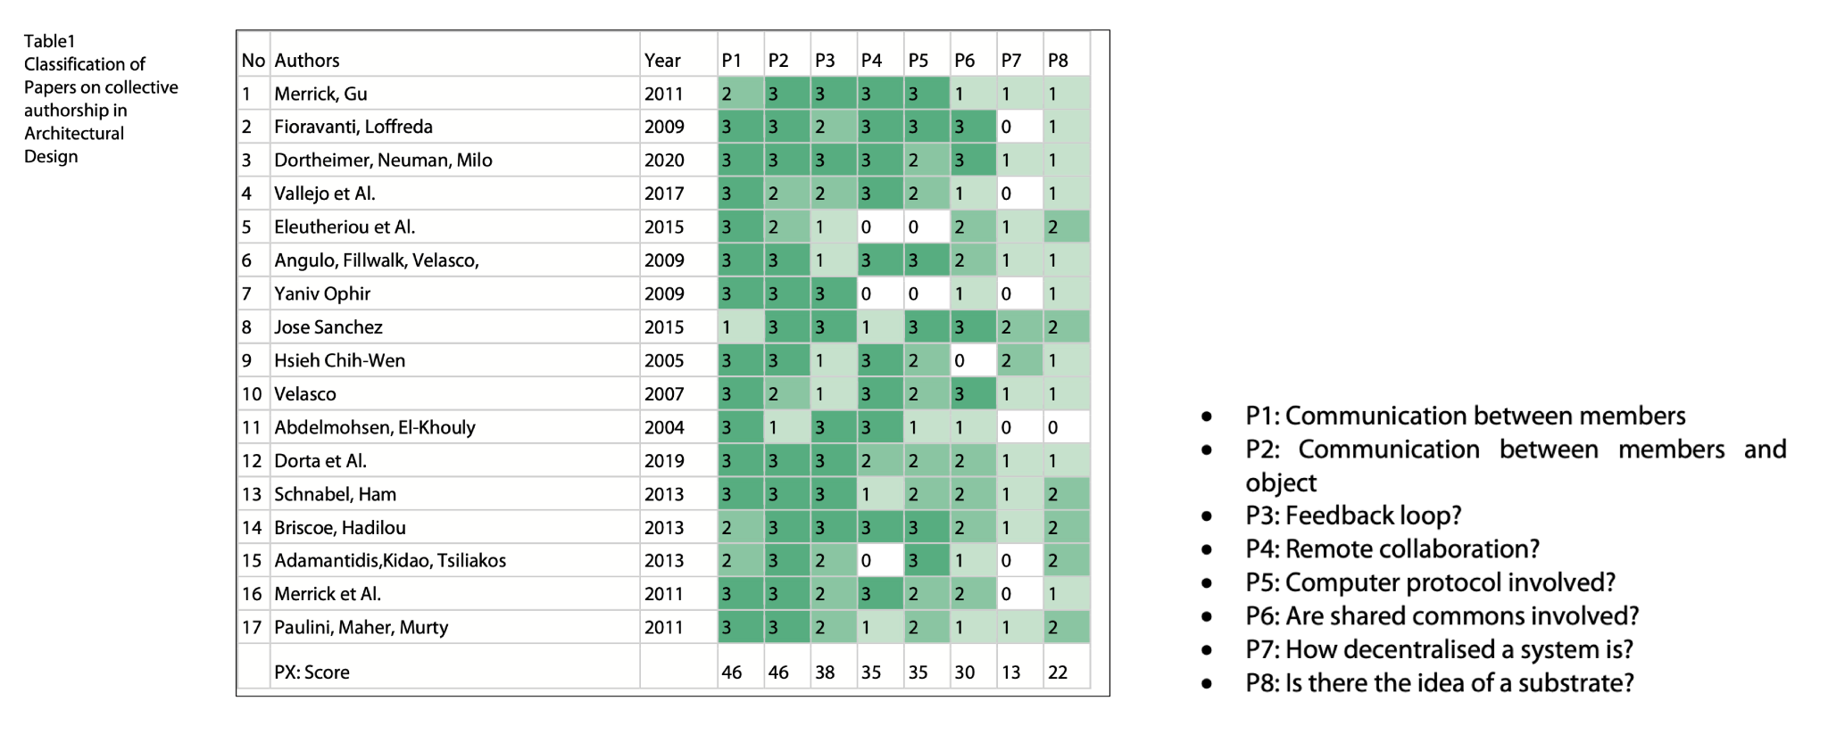
Collective authorship
Smart contracts
as the substrate medium that enables stigmergy

Slide 14
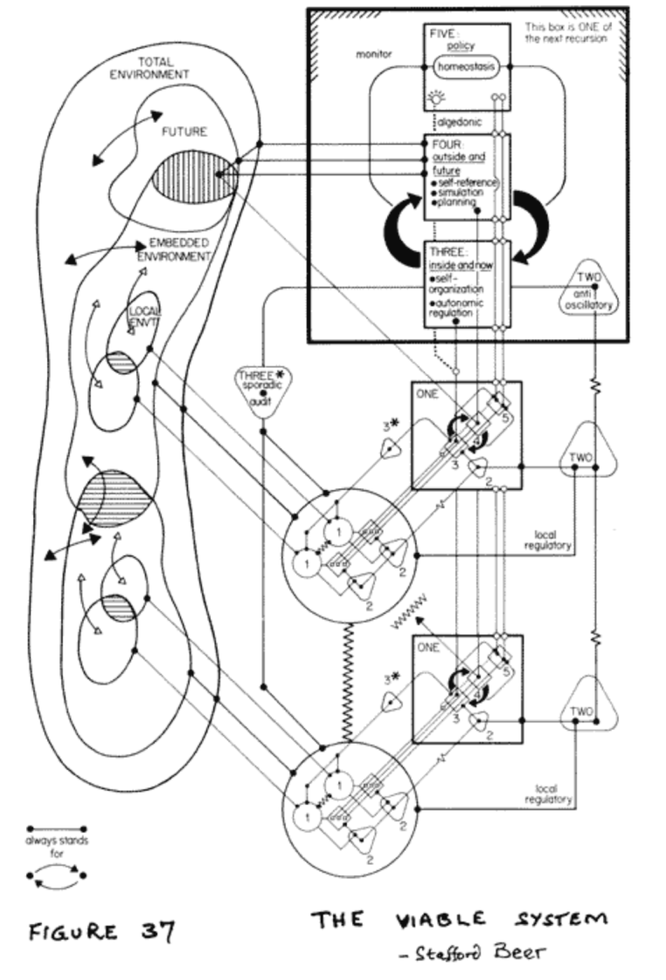
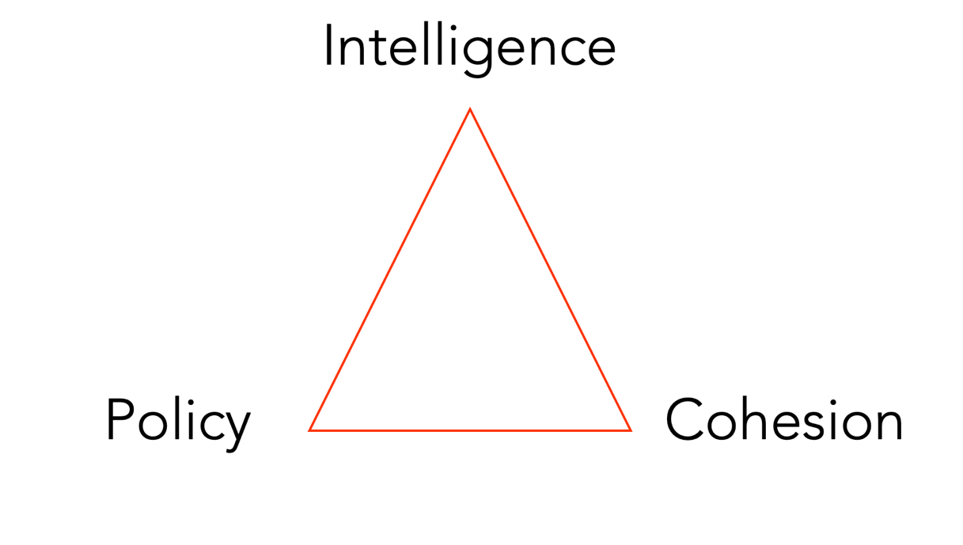
Viable System Model
The underlying model for CyberSyn: A distributed decentralised system, where edge nodes – work units can make decisions autonomously, while still serving the overall purpose and cohesion of the organisation

Slide 15
Governance in DAOs – learning from practice
DAOs: Decentralised Autonomous Organisations
DAOstack: Holographic consensus – members are rewarded for correct decisions & scaling attention
Colony: No voting – reputation based

Slide 16
Stigmergic principles

Slide 17

Stigmergy [stigma+ergo : sign+work]
Incentives
Trust
Common pool resources
Decentralised Autonomous Organisations
Self governing organisations that use blockchain for decision-making and operations
Flickr account - thinboyfatter at https://www.flickr.com/photos/1234abcd/

Slide 18
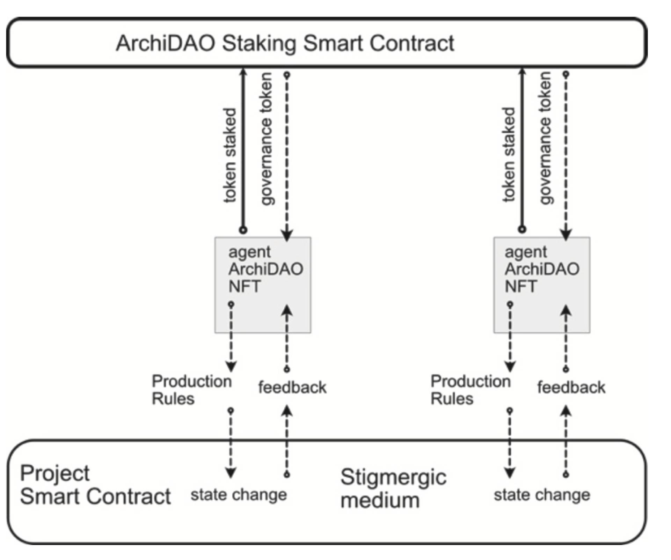
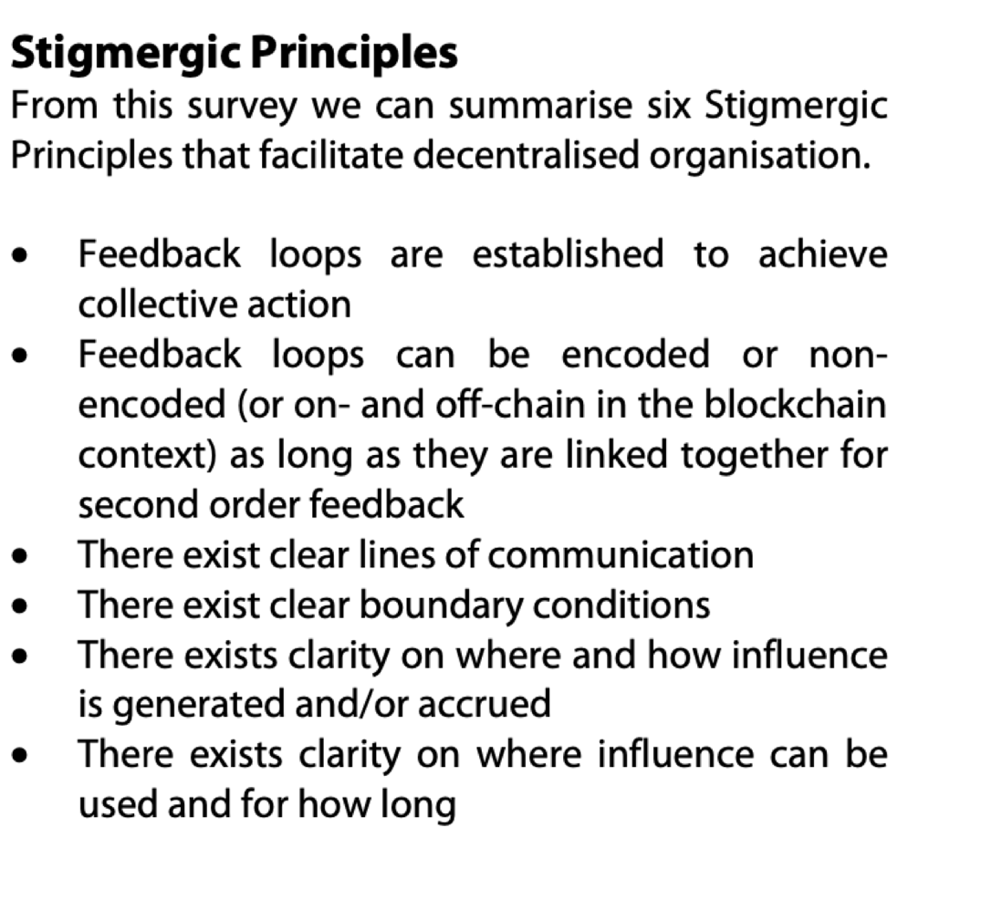
Stigmergic Principles
Organisation
Governance

Slide 19
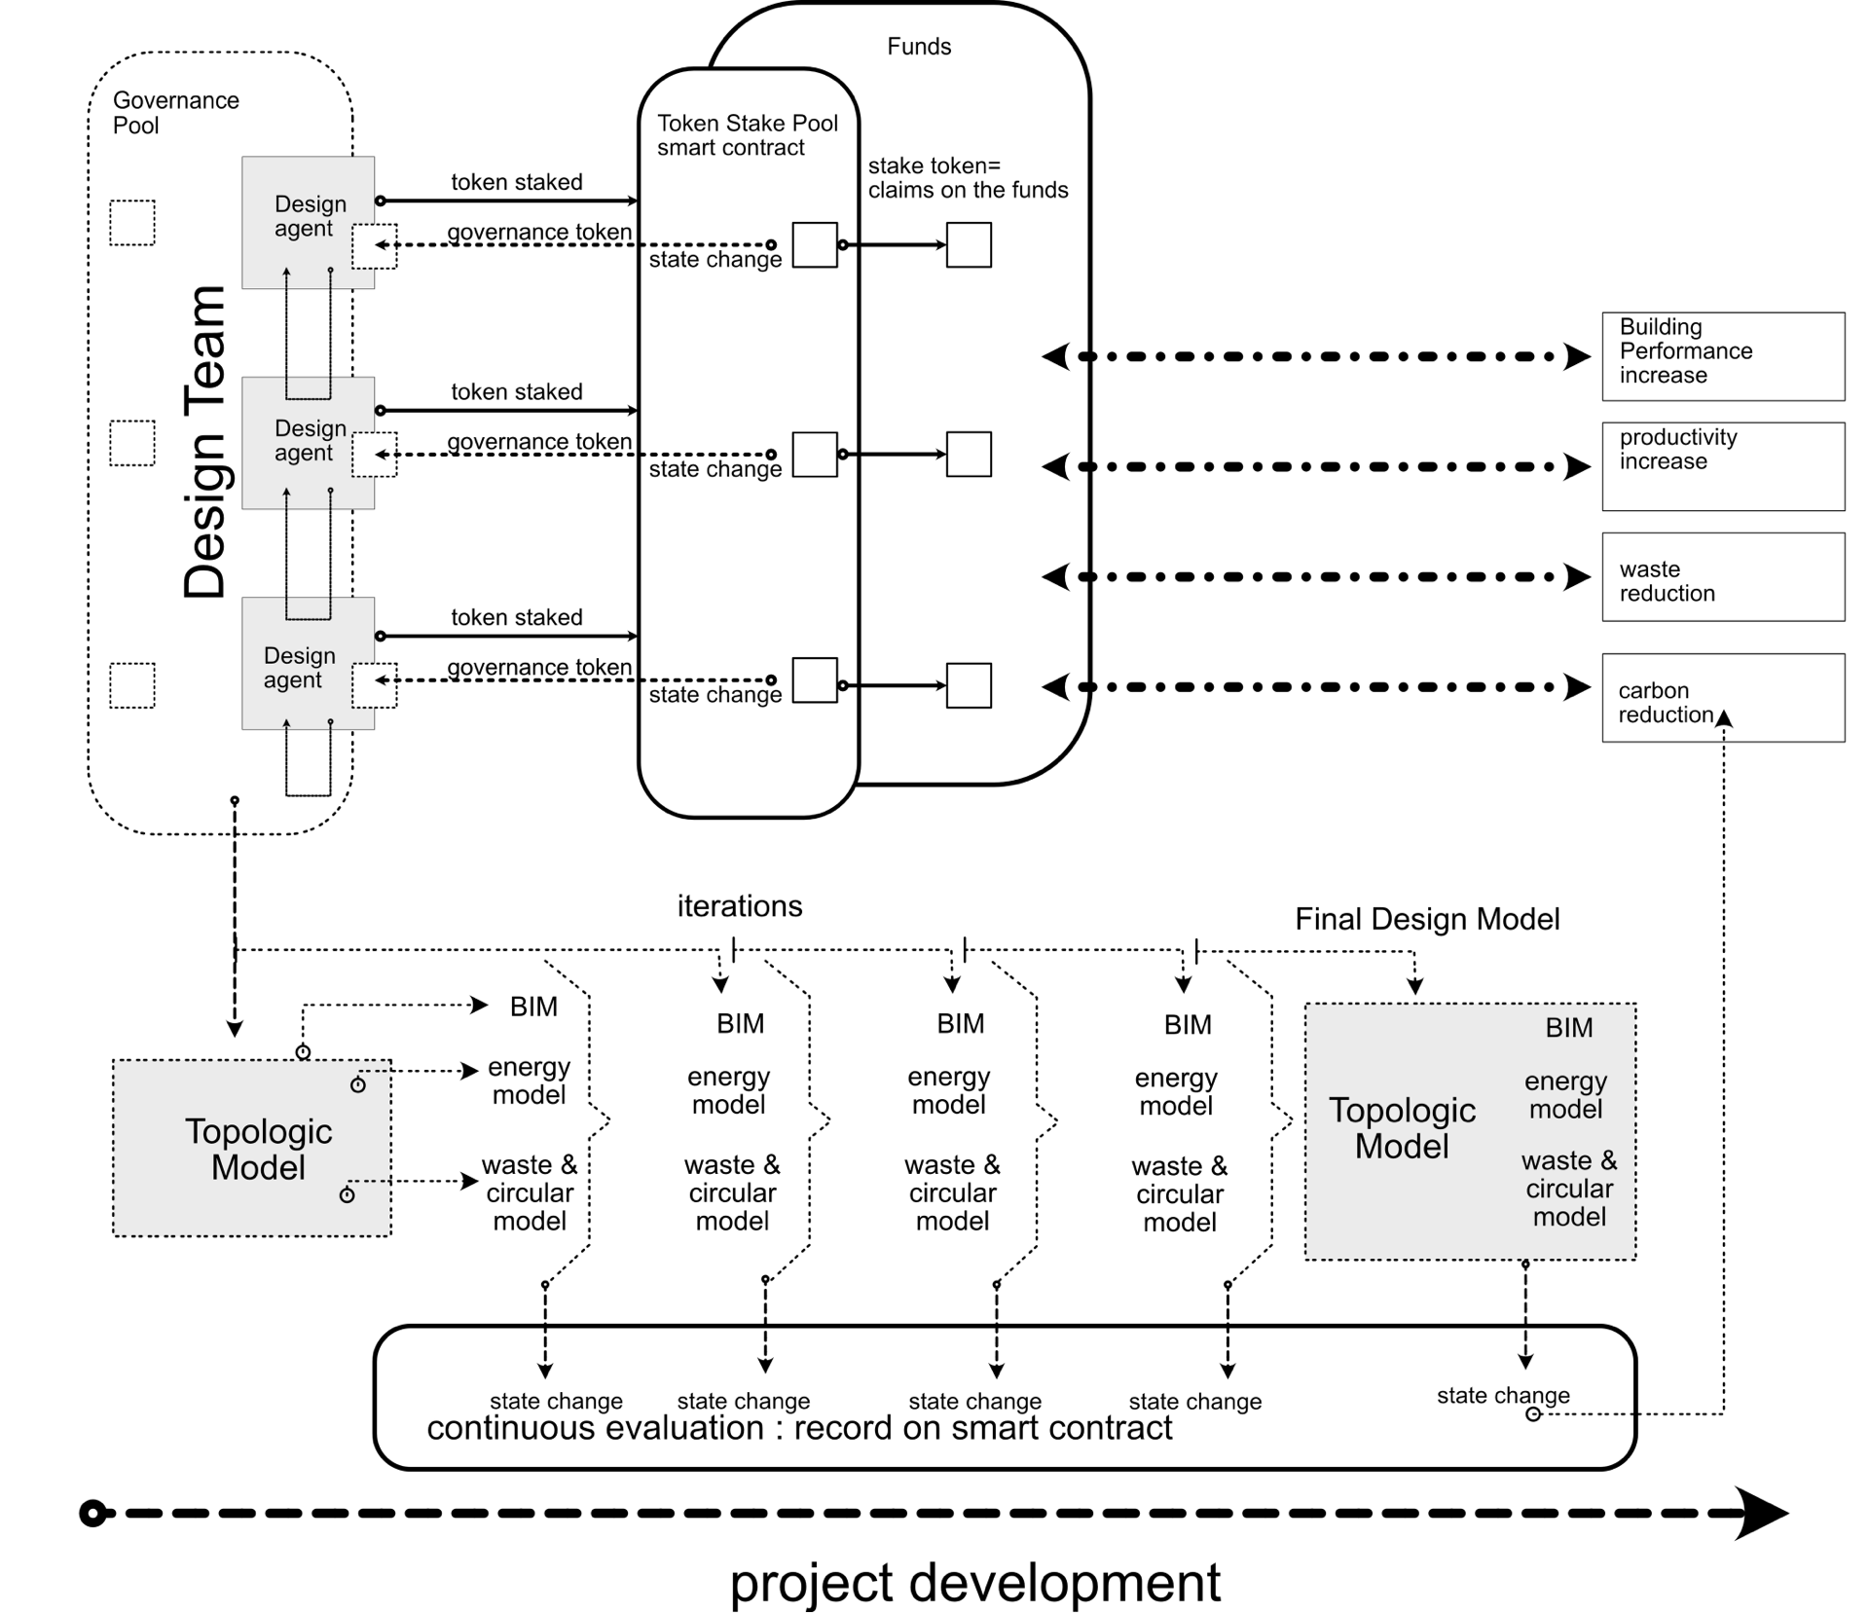

Collective Digital Factories
Springer Verlag: ISBN 9811937583 / 9789811937583

Slide 20
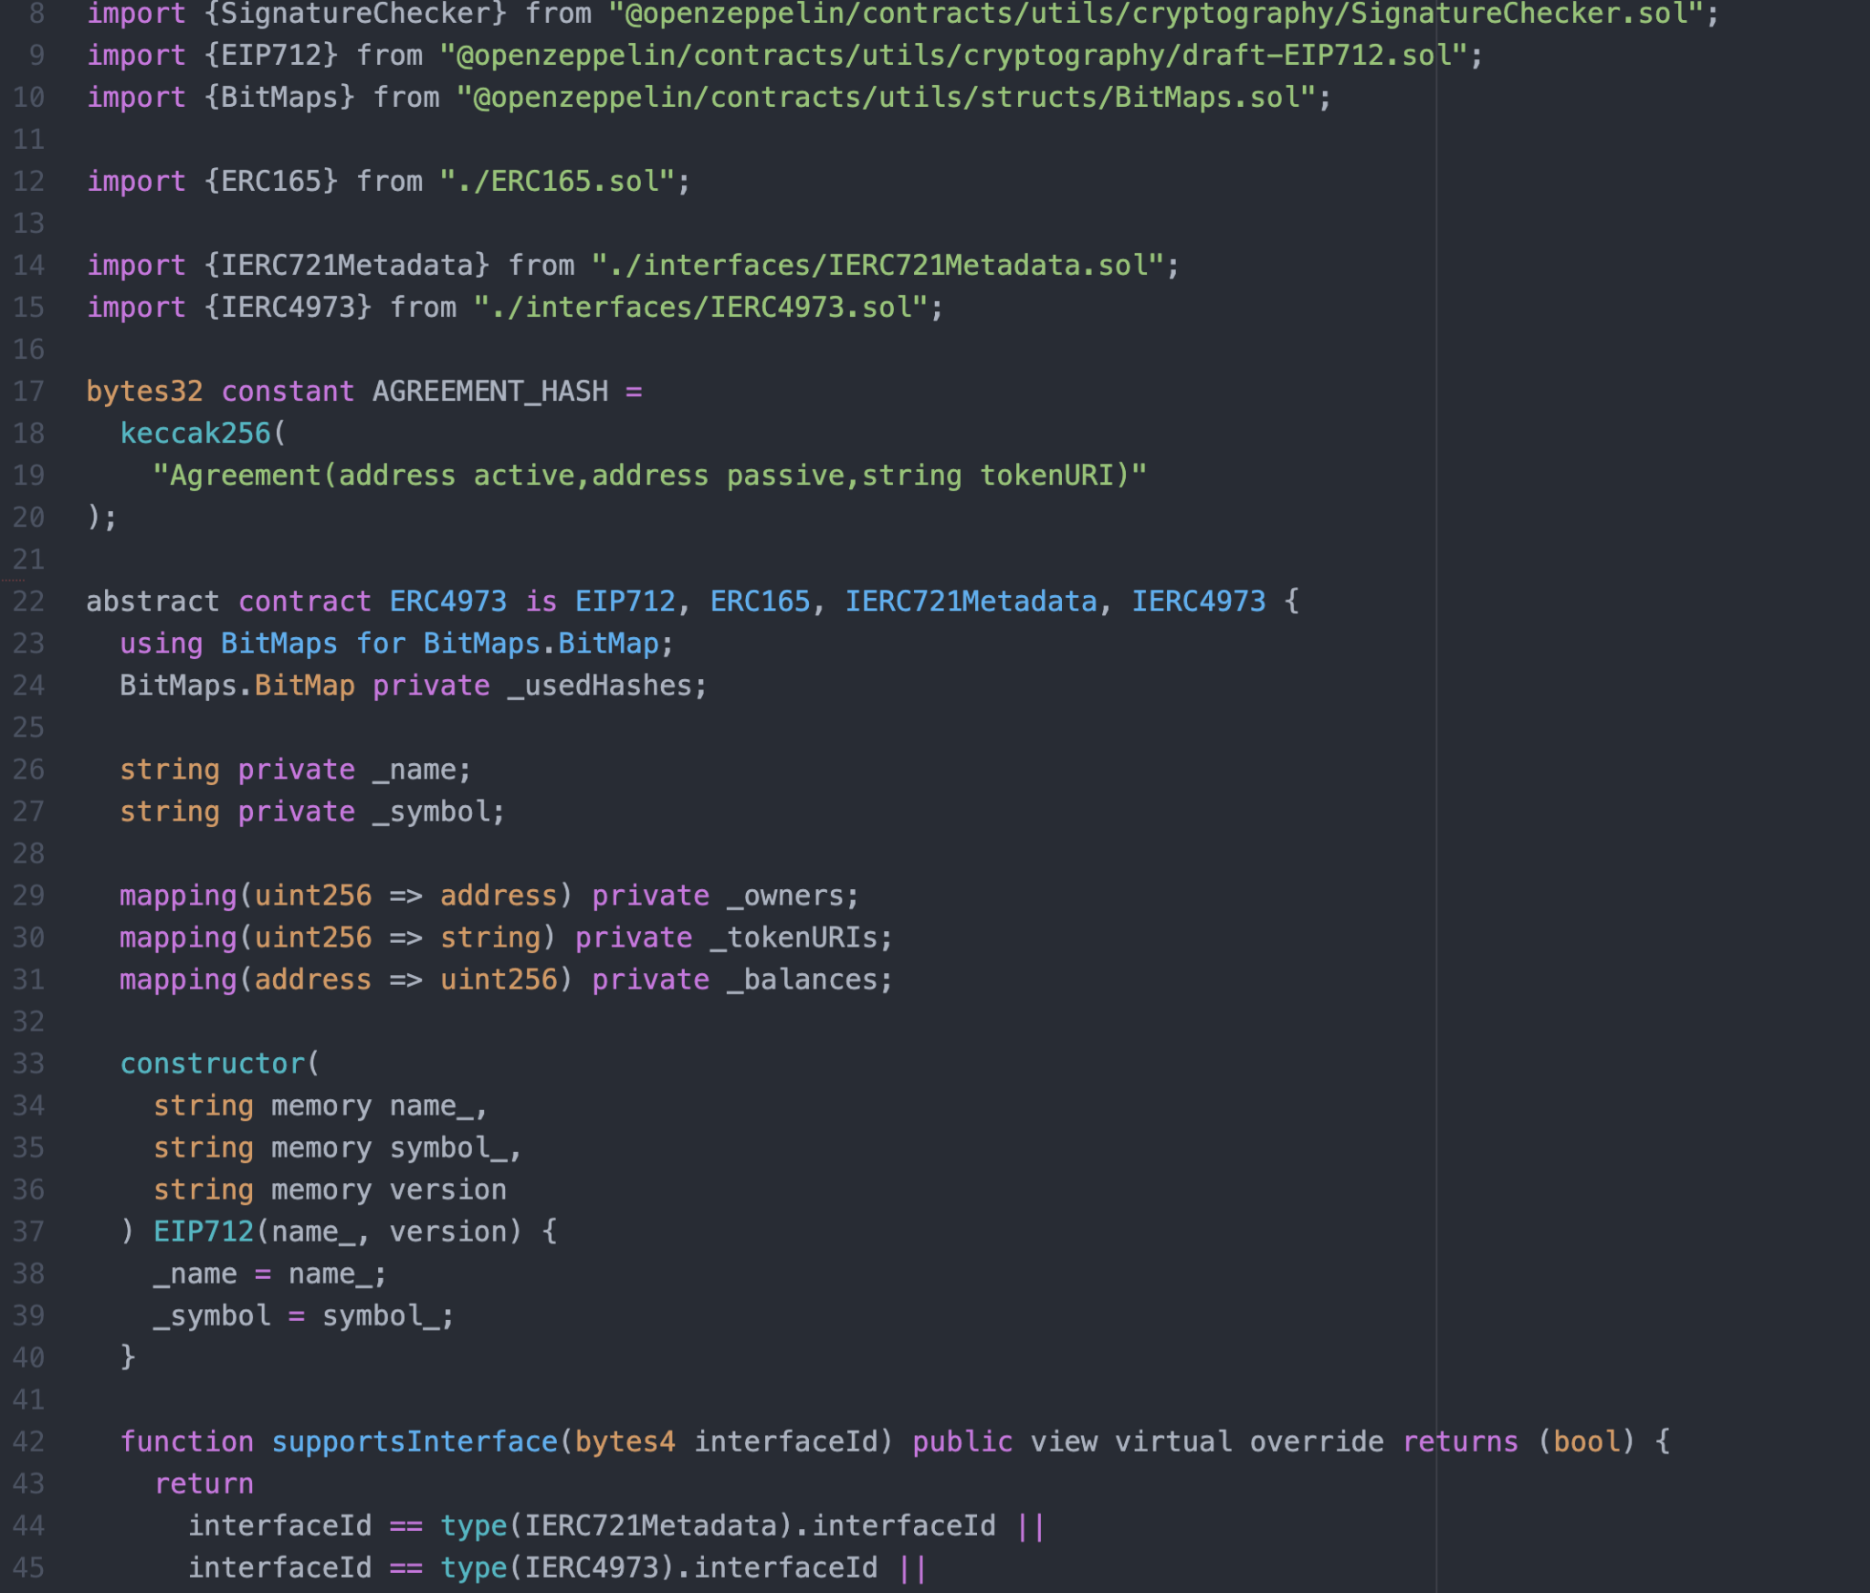
ArchiDAO Membership Non Fungible Token

Slide 21
Knowledge gaps & constraints
ArchiDAO is still under construction – this is a “living” lab experiment
Questions of Scale & Performance
How do other stakeholders participate?
Notes:
Illustrate through Briken et al -2018 / Steinhoff 2021

Slide 22
Questions?

